Slide 1
الاسم: احمد ابراهيم علي عيده الفرقة : الرابعة سكشن: 1
How Network Address Translation Works & Testing and Troubleshooting on NAT

Slide 3

How Network Address Translation (NAT) Works
Network Address Translation (NAT) is a process that allows devices with private IP addresses to communicate with devices on the internet using a single public IP address.

Slide 4
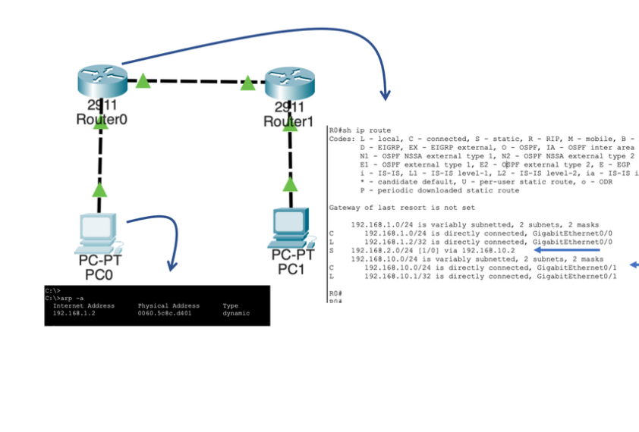
Here's how it works: 1. Private Device Sends Packet
When a device with a private IP address sends a packet to a device with a public IP address, the NAT device intercepts the packet.

Slide 5
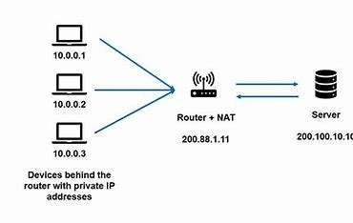
2. NAT Replaces IP Address
The NAT device replaces the private IP address with a public IP address from its pool of available addresses.

Slide 6
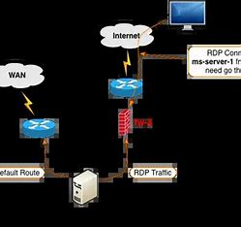
3. Packet Forwarded to Destination
The NAT device then forwards the packet to the destination device using the public IP address.

Slide 7
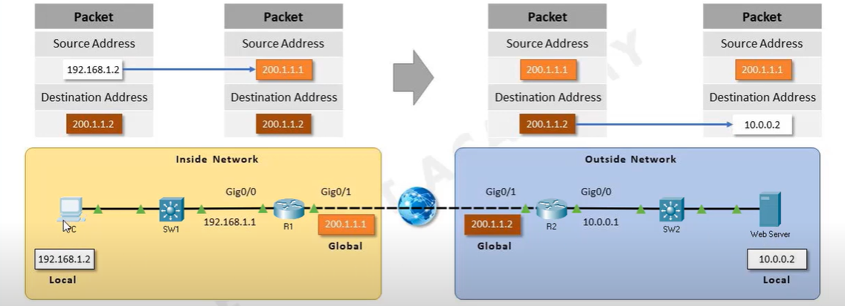
4. Communication with Internet Devices
By replacing the private IP address with a public IP address, the private device is able to communicate with devices on the internet using the single public IP address assigned by the NAT device.

Slide 8
Testing and Troubleshooting on Network Address Translation (NAT)
Testing and troubleshooting Network Address Translation (NAT) issues can be crucial for ensuring proper communication between devices in a network. NAT is commonly used to conserve public IP addresses and allows multiple devices on a local network to share a single public IP address. Here are some steps you can take to test and troubleshoot NAT-related problems:

Slide 9
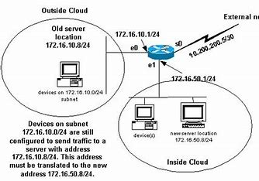
1. Check NAT Configuration:
Verify that NAT is configured correctly on the router or firewall. Ensure that the translation table is properly mapping private IP addresses to public IP addresses.

Slide 10
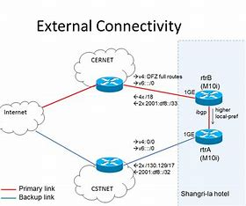
2. Verify External Connectivity:
Confirm that the router/firewall has a valid public IP address and is connected to the internet.
Check if external devices can reach the public IP address assigned to your network.

Slide 11
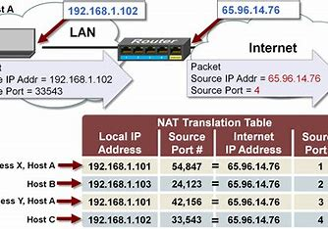
3. Check NAT Table:
Review the NAT translation table to ensure that entries are correctly mapping private IP addresses to public ones.
Check for any limitations on the number of concurrent NAT translations if applicable.

Slide 12
4. Test Internal Connectivity:
Ensure that devices within the local network can communicate with each other. Internal communication should not be affected by NAT.
5. Inspect Firewall Rules:
Check firewall rules on the router/firewall to ensure that they are not blocking necessary traffic.

Slide 13
6. Test Specific Applications:
If certain applications or services are not working, test them individually. Some applications may use non-standard ports, and you may need to create specific NAT rules.
7. Check NAT Type:
Be aware of the type of NAT being used. Common types include Static NAT, Dynamic NAT, and PAT (Port Address Translation). Each has different use cases and implications.

Slide 14
8. Verify IP Addresses:
Ensure that devices on the local network have valid private IP addresses and are configured to use the correct default gateway.
9. Look for NAT Overloading Issues:
If using PAT, check for port exhaustion. If the NAT device runs out of available ports, it can cause connectivity issues.

Slide 15
10. Packet Captures and Logs:
Use packet capture tools or check logs on the router/firewall to identify if traffic is being translated correctly or if there are any errors.
11. Update Firmware/Software:
Ensure that your router or firewall is running the latest firmware or software. Bugs or issues may be addressed in newer releases.

Slide 16
12. Temporary Bypass:
Temporarily bypass the NAT device and connect a device directly to the internet to see if the issue persists. This can help identify if the problem is related to NAT or another network component.
13. Consult Vendor Documentation:
Refer to the documentation provided by the router/firewall manufacturer for specific troubleshooting steps and recommendations.

Slide 17
14. Consult with ISP:
If the issue persists, contact your Internet Service Provider (ISP) to verify that there are no issues on their end, especially if your network relies on a dynamic public IP address.
By systematically going through these steps, you can identify and resolve issues related to Network Address Translation in your network.

